Slide 1

NIT RAIPUR
SEMESTER PROJECT PRESENTATION
POWER FACTOR CORRECTION CIRCUIT USING BOOST CONVERTER
GUIDED BY-
DR.SACHIN JAIN
- Professor
DATE: 30-06-2025
RIDDHIRAJ BIDYABHUSAN 22117075

Slide 2
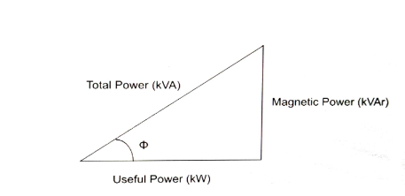

POWER FACTOR
Power factor is an expression of energy efficiency.
Active power (kW)—the useful power is the energy that is doing work.
Reactive power (kVAR)— wasted power or lost power. It’s the energy being produced that isn't doing any work, such as the production of heat or vibration.
Apparent power (kVA)— demand power, or the power being delivered by the utility.

Slide 3
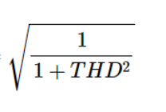
POWER FACTOR
Power factor = Displacement factor x Distortion factor
Displacement factor = cos(Φ)
It is one of the factors that affect the power factor. It occurs when voltage and current waves in a circuit are out of phase.
Distortion factor =
It occurs when the original shape of a wave is altered (distortion in the waveform).

Slide 4
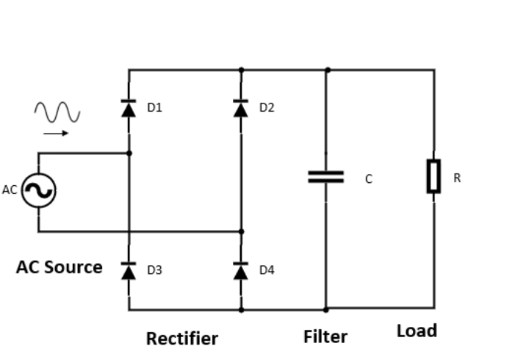
RECTIFIER
A rectifier is an electrical device that converts alternating current(AC), which periodically reverses direction, to direct current(DC),which is in only one direction, a process known as rectification.
A capacitor is included in the rectifier circuit to act as a filter to reduce ripple voltage.
The higher the capacitor value the less pulsating the output waveform will be.

Slide 5
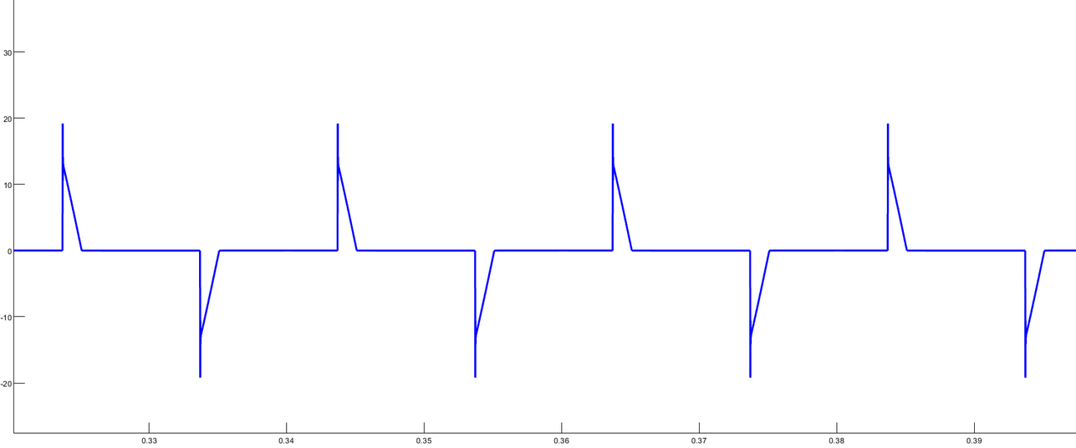
PEAKY CURRENT
Peaky currents occur due to the presence of non-linear electronic devices in the system.
This distortion in the input current implies the existence of harmonics which contribute to poor power factor.
Fundamental frequencies show active power whereas harmonics show reactive power.
The boost converter is applied to reduce harmonics and achieve a sinusoidal input current waveform.

Slide 6
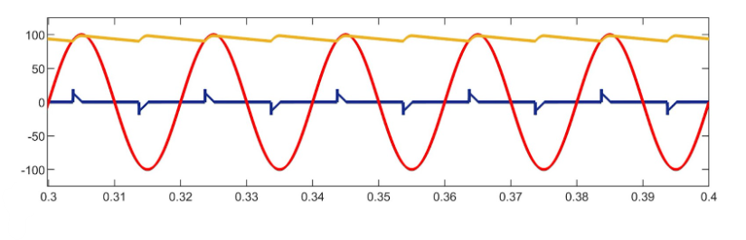
The red line represents the input voltage, the blue line represents the input current and the yellow line represents the output voltage.

Slide 7
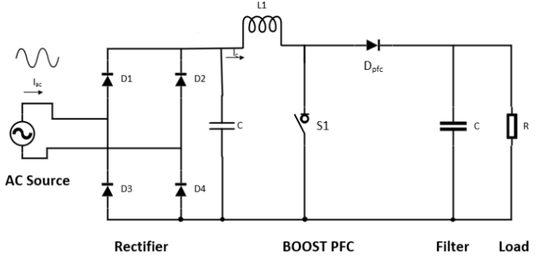
POWER FACTOR CORRECTION BY BOOST CONVERTER
The rectifier circuit is complemented by a switch(MOSFET), a diode, a capacitor and an inductor.
Adding these elements allows the circuit to adjust input current, aligning it with the voltage waveform. This reduces distortion and improves the power factor.

Slide 8
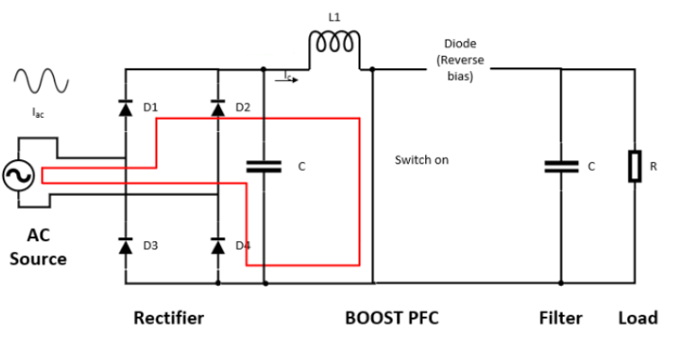
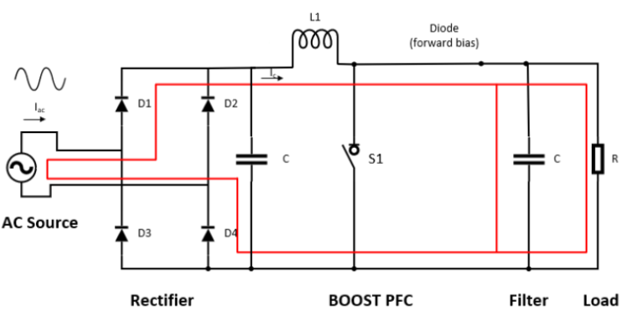
When the switch is turned on, the inductor is being energized by the AC side of the circuit via the rectifier, and thus the inductor current will be increasing.
when the switch is open, the inductor de-energizes (the current decreases) as it supplies energy to the load and for recharging the capacitor.

Slide 9
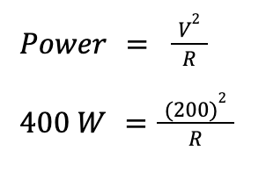
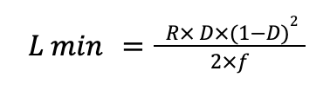
DESIGN GUIDE
Designing for 400 W , Input voltage is 100 VAC and output voltage should be 200 VDC and switching frequency is 5000Hz.
Duty cycle
Duty cycle = 1 - Vin/Vout = 0.5
Load Resistor selection
R = 100 Ohm
Inductor Selection
= 1.25mH

Slide 10
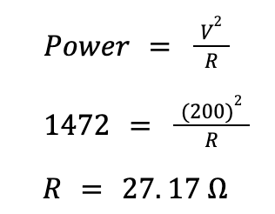

But the waveform is shown in continuous conduction mode for a short time in duty cycle , for that by finding the maximum value of power in CCM mode to redesign the value of the inductor.
Redesigning of Inductor
L = 0.33 mH

Slide 11
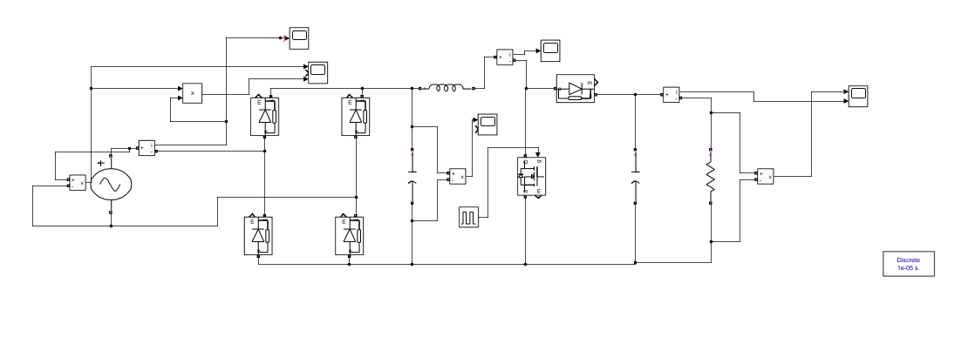
SIMULATION
Input Voltage =100 V(rms)
Input Frequency = 50 Hz
Filter Capacitor = 10 µF
Inductor = 0.339 mH
Boost Capacitor = 10 mF
Switching Frequency = 5 KHz
Duty Cycle = 50 %
8.Load Resistance = 100 Ω

Slide 12
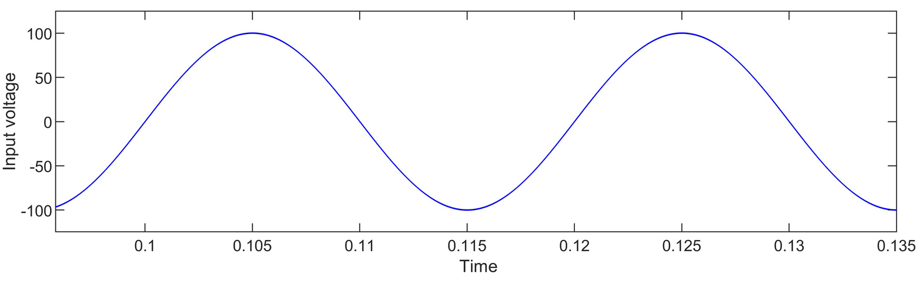
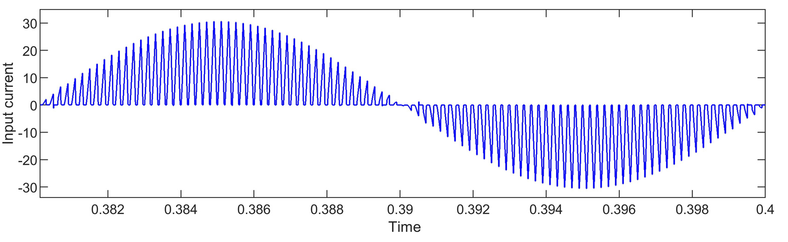
WAVEFORMS
The first figure depicts the waveform of input voltage which is a sinusoidal waveform with an amplitude of 100 V.
The second figure displays the input current waveform which is sinusoidal in nature, a result of incorporating the boost converter into the circuit.

Slide 13
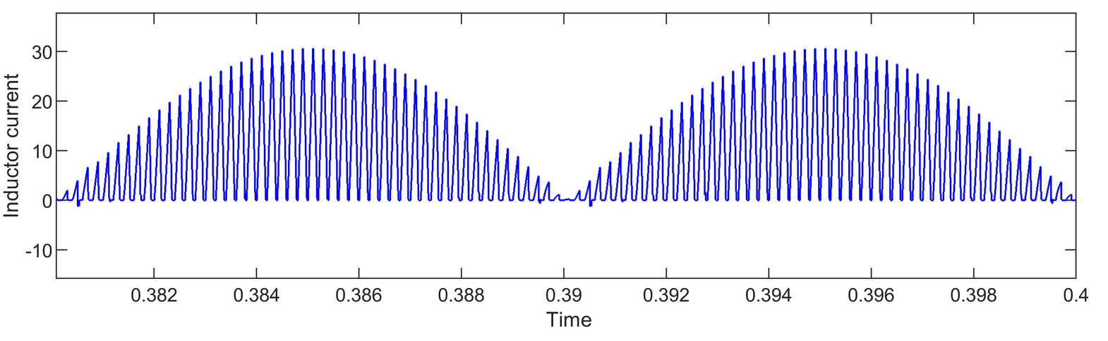
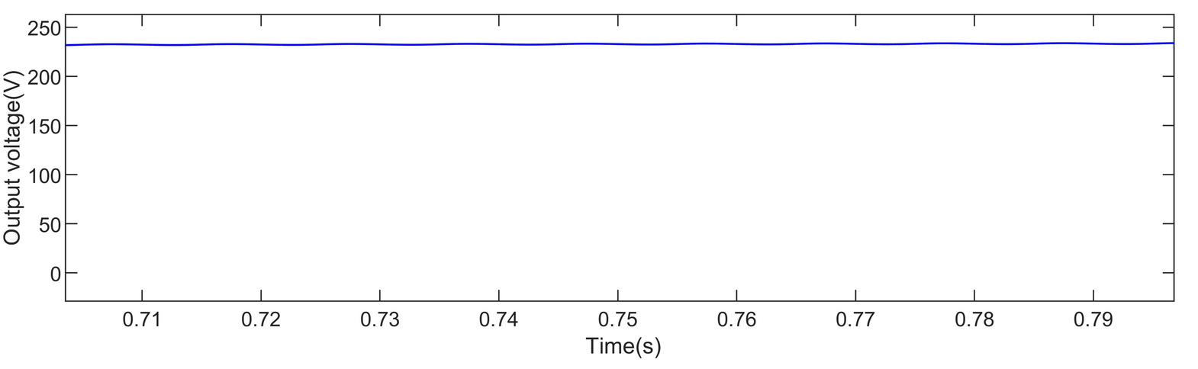
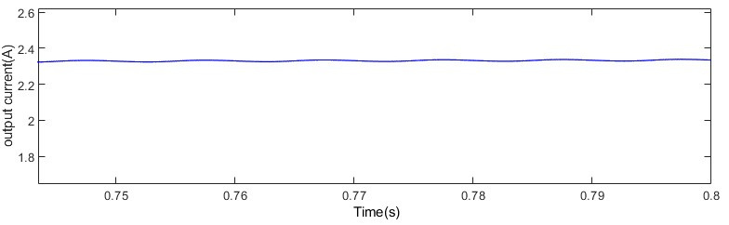
These are the waveform of inductor current , output voltage and output current.

Slide 14
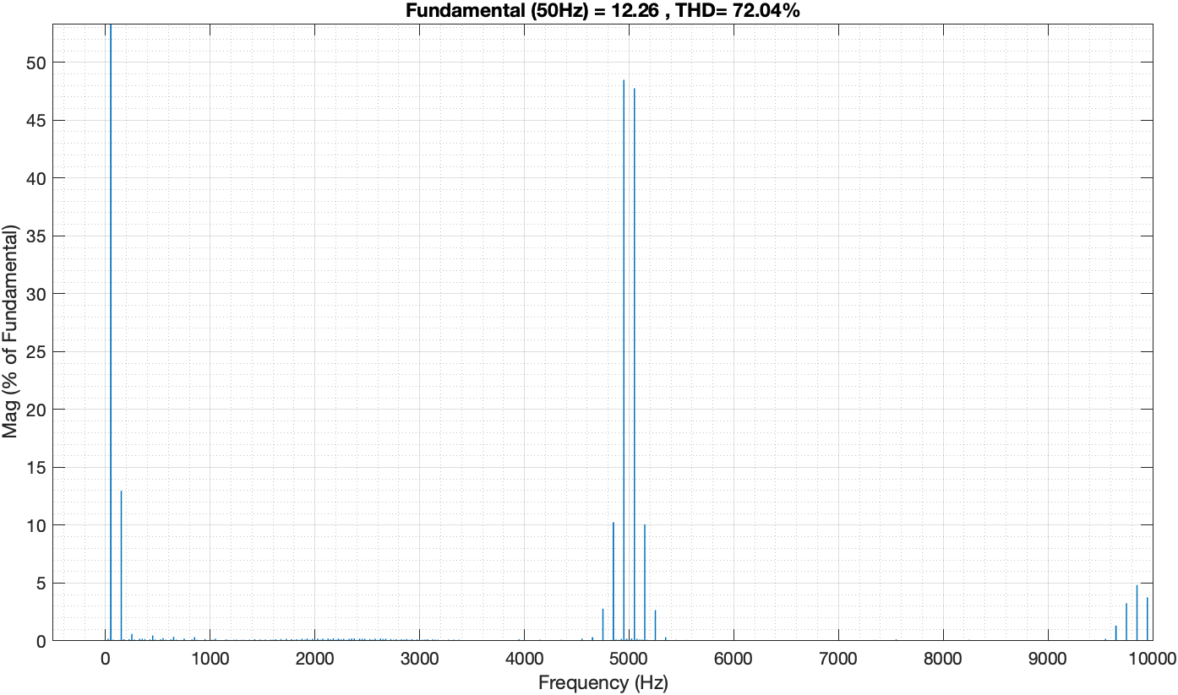
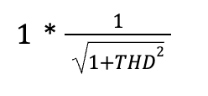
TOTAL HARMONIC DISTORTION FACTOR
THD for PFC boost converter is 72.04%
PF =
PF = 0.656
As around 5000 Hz harmonics is present so for decreasing the distortion low pass filter is used.

Slide 15
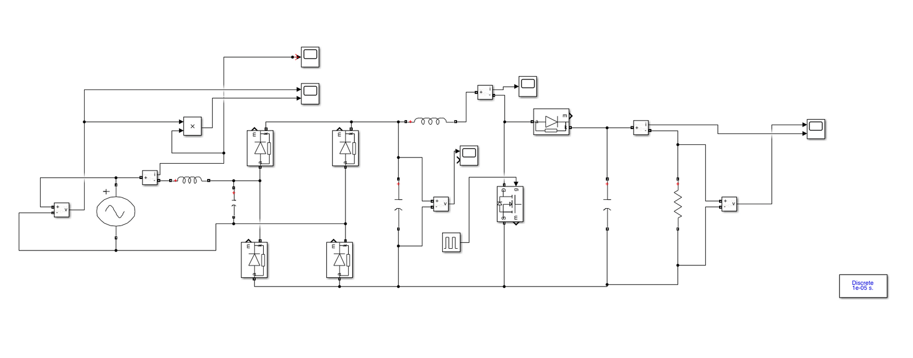
PFC BOOST CONVERTER WITH LOW PASS FILTER
Filter values
Low Pass Filter Inductor = 1 mH
Low Pass Filter Capacitor = 2.2 µF

Slide 16
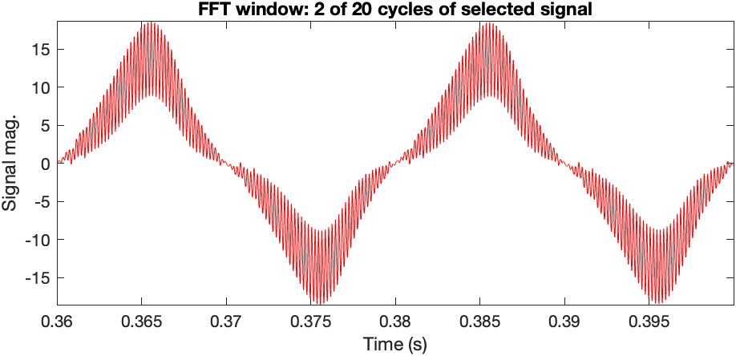
LINE CURRENT

Slide 17
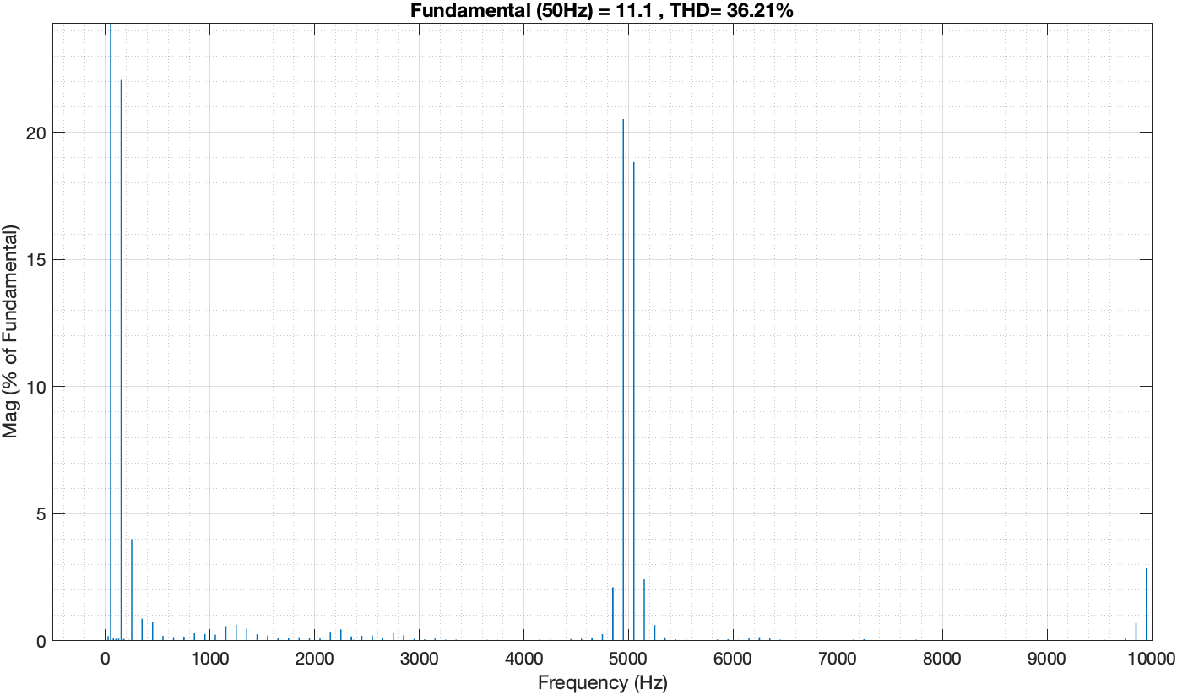
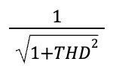
THD FOR LOW PASS FILTER PFC BOOST CONVERTER
THD for low pass filter PFC boost converter = 36.12%
PF =
PF = 0.8844

Slide 18
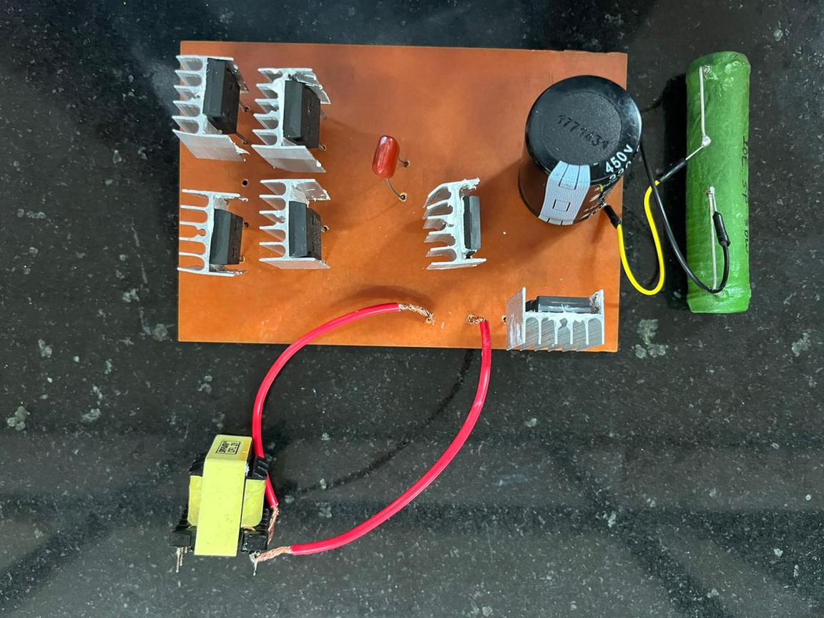
HARDWARE MODEL

Slide 19
CONCLUSION
Power Factor is improved from 0.207 to 0.884.
The total harmonics distortion is decreased to 36.12% .
The input current gets close to sinusoidal waveform.

Slide 20
FUTURE SCOPE
This project is made for open loop where manually duty cycle is being changed.
For future closed loop control a closed-loop system is introduced to the circuit. This controller dynamically adjusts the duty cycle based on feedback received from the output side and aligns the input current to sinusoidal shape.

Slide 21
REFERENCE
Fang Lin Luo, "Single-stage power factor correction AC/DC converter," 2005 International Power Engineering Conference, Singapore, 2005, pp. 974-979 Vol. 2, doi: 10.1109/IPEC.2005.207049.
Rectifiers for power factor correction (PFC) 2016 , accessed 18 Oct 2023 , <https://www.vishay.com/docs/88868/anpfc.pdf>.
https://resources.system-analysis.cadence.com/blog/msa2020-improve-power-factor-and-efficiency-using-bridgeless-power-factor-correction-rectifiers
https://www.allaboutcircuits.com/technical-articles/how-the-boost-pfc-converter-circuit-improves-power-quality/
https://www.monolithicpower.com/en/power-factor-correction

